Slide 1
Taxi Rides Transactional Dataset
Prepared By : Aakanksha Pednekar
Date : 30-01-2026 to 05-02-2026

Slide 2
OBJECTIVE
To Analyze large ‑ scale Taxi Ride Transactional Data.
To Create Dashboard using Power BI .
Identifying trends across Time, Payment Types, Companies .
Convert analytical results into business‑ready insights .

Slide 3
Overview
Multi-year Taxi Ride Transactional Dataset
Contains:
Records of completed Taxi journeys .
Pickup and Drop-off location details .
Distance travelled and trip duration .
Fare amount , tips , toll charges, additional fees, and total trip cost
Payment methods and operating companies
Date and time information for each trip

Slide 4
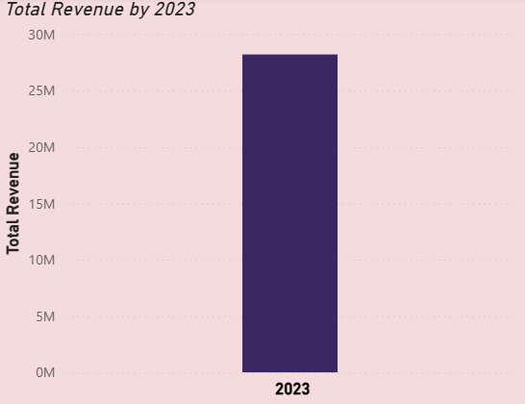
Total Revenue In Year 2023
Total Revenue Generate by Taxi services in 2023 .
Overall including all companies together, generated more than 28+Mili , which is pretty strong.
It shows that very much customers preferred Taxi Services.
Taxi business performed well in 2023.

Slide 5
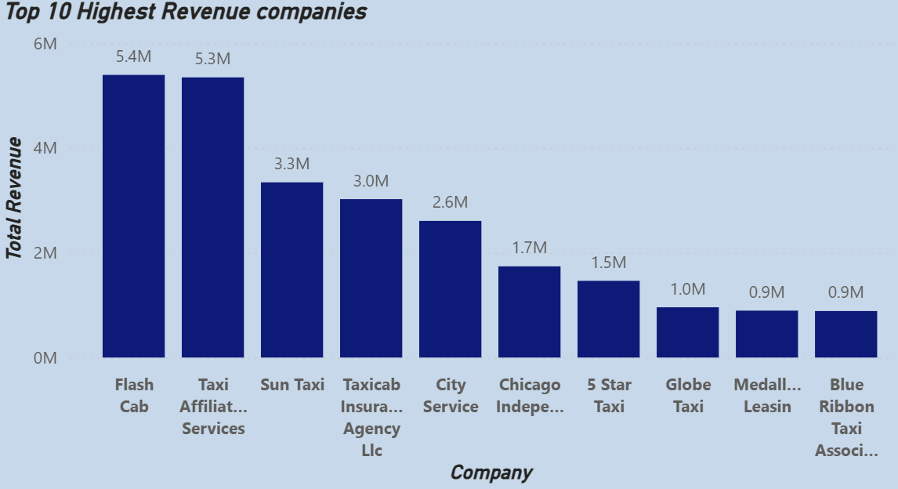
Top Revenue Companies
These 10 Companies have the highest Revenues .
Flash Cab is Highest Revenue generating company with almost 5.5 Million. It is almost 20% of the Total Revenue.

Slide 6
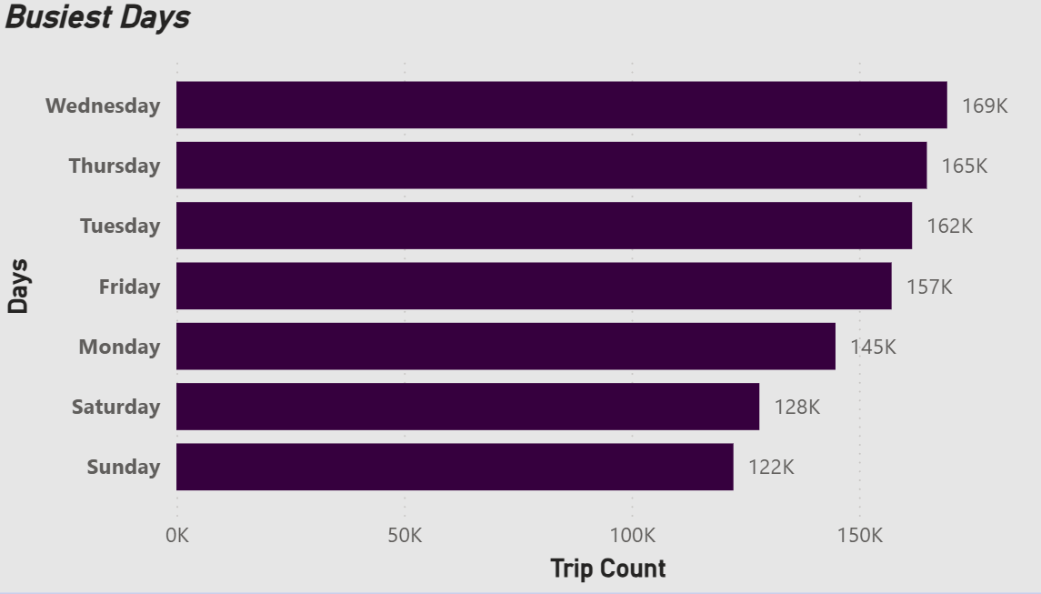
Busiest Days
Weekdays have more taxi trips than weekends .
Wednesday, Thursday and Tuesday show highest taxi rides activity .
It shows that , Taxi demand is higher on working days compared to Weekends.

Slide 7
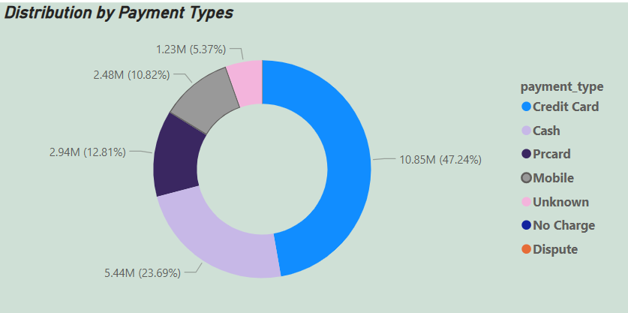
Payment Type Distribution
Most passengers use card payments.
Cash is the second most common method .
Mobile and other methods are used less .
Still , by analysing it shows that Most of the Customers prefer cashless payments.

Slide 8
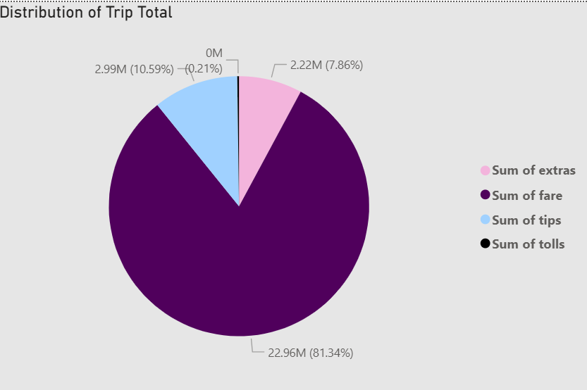
Revenue Breakdown
Total revenue is calculated as the sum of fare, tips, tolls, and extra charges.
Fare remains the primary source of income also its is the largest portion of the Total Revenue.
Tips and extra charges contribute additional income
Tolls account for a very small share

Slide 9
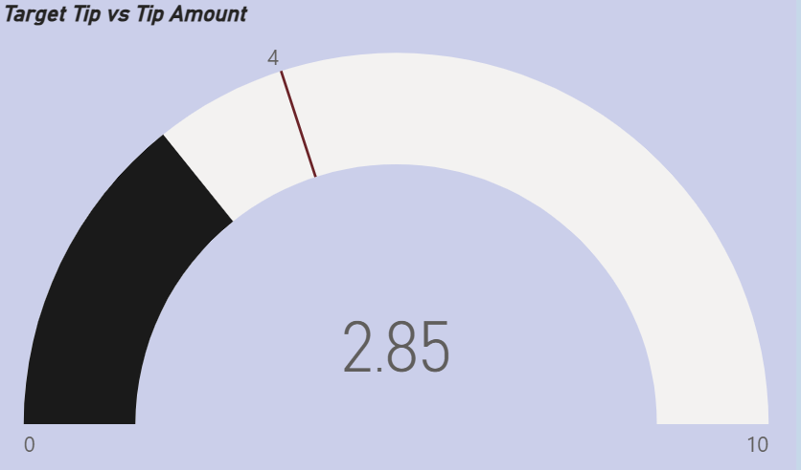
Target Tip vs Tip Amount
Average tip amount is 2.85, which is below the target value of 4
Passengers are giving tips , yet improvement is possible
Better service quality may help increase tips

Slide 10
Combined Insights
Taxi usage varies across different days and hours .
Cashless payment methods are commonly used by passengers .
Fare charges generate the largest share of income .
Ride activity changes from month to month .
On weekdays there is more taxi rides happening.
Improving customer experience and encouraging positive interactions between drivers and passengers may help increase tip amounts .

Slide 11
Thank you!

